Slide 1
Minority Youth in Washington State’s Juvenile Justice System
Carl McCurley, Ph.D.
Thomas George, Ph.D.
Sarah Veele-Brice, Ph.D.
Jennifer Zipoy, M.A.
Administrative Office of the Courts
Washington State Center for Court Research

Slide 2
All youth age
10 to 17
Main Decision Points in the Juvenile Justice System
Arrest
Referral to Court
Diversion
Petition (charges filed)
Adjudication
Probation
JRA
Law
Enforcement
(Supervision)
Juvenile Court
Population
RRIs are calculated for each decision point

Slide 3
Cumulative Effect of Disproportionality
White
Black
Latino
Asian
AI / AN
Washington State Juvenile Population
Washington State
Youth Sentenced to JRA

Slide 4
Youth of Color Over-Represented in Transfers to Adult Court
White
Black
Latino
Asian
AI / AN
Washington State Juvenile Population
Cases Transferred to Adult Court

Slide 5
How much more likely are events for youth of color?
1992 vs. 2009
 |  | African-American |  |  | Native American |  |  | Asian/ Pacific Islander |  |  | Latino
 |  | 1992 | 2009 |  | 1992 | 2009 |  | 1992 | 2009 |  | 1992 | 2009
Arrest |  | 1.7 | 1.8 |  | 1.0 | 1.3 |  | 0.4 | 0.3 |  | 0.7 | N/A
Referred to court |  | 4.9 | 2.7 |  | 1.4 | 2.1 |  | 0.9 | 0.5 |  | 1.1 | 1.4
Diverted |  | 0.6 | 1.6 |  | 0.8 | 1.3 |  | 0.9 | 0.6 |  | 0.1 | 1.2
Prosecuted |  | 3.3 | 3.8 |  | 1.3 | 2.5 |  | 0.6 | 0.6 |  | 1.1 | 1.7
Adjudicated guilty |  | 2.6 | 3.7 |  | 1.2 | 2.4 |  | 0.6 | 0.6 |  | 1.1 | 1.8
Confined in state facility |  | 7.1 | 5.2 |  | 2.8 | 2.5 |  | 0.7 | 0.9 |  | 1.9 | 1.7

Slide 6
How much more likely are events for youth of color?
1992 vs. 2009
 |  | African-American |  |  | Native American |  |  | Asian/ Pacific Islander |  |  | Latino
 |  | 1992 | 2009 |  | 1992 | 2009 |  | 1992 | 2009 |  | 1992 | 2009
Arrest |  | 1.7 | 1.8 |  | 1.0 | 1.3 |  | 0.4 | 0.3 |  | 0.7 | N/A
Referred to court |  | 4.9 | 2.7 |  | 1.4 | 2.1 |  | 0.9 | 0.5 |  | 1.1 | 1.4
Diverted |  | 0.6 | 1.6 |  | 0.8 | 1.3 |  | 0.9 | 0.6 |  | 0.1 | 1.2
Prosecuted |  | 3.3 | 3.8 |  | 1.3 | 2.5 |  | 0.6 | 0.6 |  | 1.1 | 1.7
Adjudicated guilty |  | 2.6 | 3.7 |  | 1.2 | 2.4 |  | 0.6 | 0.6 |  | 1.1 | 1.8
Confined in state facility |  | 7.1 | 5.2 |  | 2.8 | 2.5 |  | 0.7 | 0.9 |  | 1.9 | 1.7

Slide 7
How much more likely are events for youth of color?
1992 vs. 2009
 |  | African-American |  |  | Native American |  |  | Asian/ Pacific Islander |  |  | Latino
 |  | 1992 | 2009 |  | 1992 | 2009 |  | 1992 | 2009 |  | 1992 | 2009
Arrest |  | 1.7 | 1.8 |  | 1.0 | 1.3 |  | 0.4 | 0.3 |  | 0.7 | N/A
Referred to court |  | 4.9 | 2.7 |  | 1.4 | 2.1 |  | 0.9 | 0.5 |  | 1.1 | 1.4
Diverted |  | 0.6 | 1.6 |  | 0.8 | 1.3 |  | 0.9 | 0.6 |  | 0.1 | 1.2
Prosecuted |  | 3.3 | 3.8 |  | 1.3 | 2.5 |  | 0.6 | 0.6 |  | 1.1 | 1.7
Adjudicated guilty |  | 2.6 | 3.7 |  | 1.2 | 2.4 |  | 0.6 | 0.6 |  | 1.1 | 1.8
Confined in state facility |  | 7.1 | 5.2 |  | 2.8 | 2.5 |  | 0.7 | 0.9 |  | 1.9 | 1.7

Slide 8
How much more likely are events for youth of color?
1992 vs. 2009
 |  | African-American |  |  | Native American |  |  | Asian/ Pacific Islander |  |  | Latino
 |  | 1992 | 2009 |  | 1992 | 2009 |  | 1992 | 2009 |  | 1992 | 2009
Arrest |  | 1.7 | 1.8 |  | 1.0 | 1.3 |  | 0.4 | 0.3 |  | 0.7 | N/A
Referred to court |  | 4.9 | 2.7 |  | 1.4 | 2.1 |  | 0.9 | 0.5 |  | 1.1 | 1.4
Diverted |  | 0.6 | 1.6 |  | 0.8 | 1.3 |  | 0.9 | 0.6 |  | 0.1 | 1.2
Prosecuted |  | 3.3 | 3.8 |  | 1.3 | 2.5 |  | 0.6 | 0.6 |  | 1.1 | 1.7
Adjudicated guilty |  | 2.6 | 3.7 |  | 1.2 | 2.4 |  | 0.6 | 0.6 |  | 1.1 | 1.8
Confined in state facility |  | 7.1 | 5.2 |  | 2.8 | 2.5 |  | 0.7 | 0.9 |  | 1.9 | 1.7

Slide 9
What is a Relative Rate Index (RRI)?
Number of Minority Contacts
Rate of
Minority Contact
Minority Population
Relative Rate Index
Number of White Contacts
Rate of
White Contact
White
Population
Lesser Chance of Contact
>
1
>
Greater Chance of Contact

Slide 10
Black youth almost twice as likely to be arrested
White

Slide 11
Black and American Indian youth are more than 2X more likely to be referred to court
White

Slide 12
Minority youth less likely to receive diversion
White

Slide 13
Minorities more likely to have petition filed
White

Slide 14
Adjudication of guilt does not add to DMC
White

Slide 15
Black and Asian youth more likely to go to JRA
White

Slide 16
Overlap Among Delinquency, Truancy, and Dependency
Differences in Overlap by
Race & Ethnicity

Slide 17
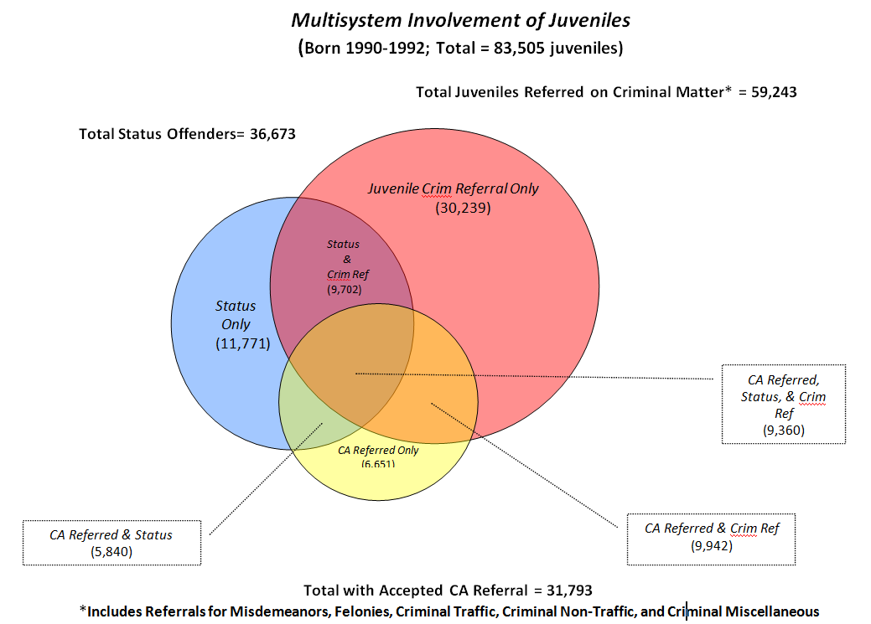
Multisystem Involvement

Slide 18
Multisystem involvement by race and ethnicity

